Slide 1
COLOUR DETECTION USING OPENCV AND PANDAS
BATCH NUMBER : A2
GUIDE NAME : Dr. K.Sangeetha M.E , PhD.,Associate Professor
PRESENTED BY:
ARUNA K - 211419104020
PREETHI B - 211419104200

Slide 2
ABSTRACT
We are going to build a python project through which we can automatically get the name of the colour by clicking on them. So for this, we will have a data file that contains the colour name and its values. we will calculate the distance from each colour and find the shortest one.

Slide 3
WHAT IS COLOUR DETECTION?
Colour detection is the process of detecting the name of any colour.
For humans this is an extremely easy task but for computers, it is not straightforward.
Human eyes and brains work together to translate light into colour. Light receptors that are present in our eyes transmit the signal to the brain.
Our brain then recognizes the colour. Since childhood, we have mapped certain lights with their colour names. We will be using the somewhat same strategy to detect colour names.

Slide 4
LITERATURE SURVEY
Year of publishing | Author name | Title of the paper | Merits | Demerits
2019 | Sahar Sabbaghi Mahmouei , Mohammad Aldeen,William V.Stoecker & Rahil Garnavi | Biologically Inspired QuadTree Color Detection in Dermoscopy Images of Melanoma | The proposed colour palette mimics human colour interpretation and detected colors and colour locations can be immediately applied in the clinic. | Application of the colour palette and QuadTree colour clustering to larger, publically available datasets is not available.
LINK | https://ieeexplore.ieee.org/document/8368055

Slide 5
Year of publishing | Author name | Title of the paper | Merits | Demerits
2019 | Xiaoyang Liu, Dean Zhao, Weikuan Jia, Wei Ji & Yueping Sun | A Detection Method for Apple Fruits Based on Color and Shape Features | The proposed method combines the colour feature and shape feature to detect fruits and can improve the accuracy of fruit detection. | Pixel-wise segmentation is more precision than detection boxes.But , the system just detects fruits by rectangle boxes.
LINK | https://ieeexplore.ieee.org/document/8720218

Slide 6
Year of publishing | Author name | Title of the paper | Merits | Demerits
2020 | Dongyun Wang, Jiawei Yin, Chu Tang, Xiaojun Cheng, Binzhao Ge | Color Edge Detection Using the Normalization Anisotropic Gaussian Kernel and Multichannel Fusion | A new edge detector is proposed based on normalizing the Anisotropic Gaussian Kernel and Multi-channel Gradient Derivative Matrix Fusion for detecting the edge of color natural scene images is more efficient in the performance of noise robustness. | It is not focused on extracting the appearance defects in color natural scene images based on the edge detection algorithm proposed in this paper.
LINK | https://ieeexplore.ieee.org/document/9292969

Slide 7
Year of publishing | Author name | Title of the paper | Merits | Demerits
2021 | Uzair Aslam Bhatti, Zhou Ming-Quan, Huo Qing-Song, Sajid Ali, Aamir Hussain,Yan Yuhuan, Zhaoyuan Yu, Linwang Yuan, Saqib Ali Nawaz | Advanced Color Edge Detection Using Clifford Algebra in Satellite Images | This study gives an advanced solution to the problems of edge detection in color images. A new area of research is explored using Clifford algebra and quaternions. | Because high-resolution, remote sensing images have the characteristics of complex scenes and multiple forms of the same target, information accuracy, timeliness etc. are still areas of challenge where progress is needed to obtain more accurate results.
LINK | https://ieeexplore.ieee.org/document/9359330

Slide 8
Year of publishing | Author name | Title of the paper | Merits | Demerits
2020 | Mengbo You, Jiahao Liu, Jian Zhang, Mingdong Xv, Dongjian He | A Novel Chicken Meat Quality Evaluation Method Based on Color Card Localization and Color Correction | This system proposes a low-cost, contactless chicken meat quality evaluation method by examining the color image of chicken meat. To eliminate the chromatic aberration, a pre-defined color card is put beside meat and automatically localized to extract the captured color information for color correction. | Colorimeter has the disadvantages of complicated time-consuming operations, high technical requirements and expensive instruments.
LINK | https://ieeexplore.ieee.org/document/9076168

Slide 9
PROBLEM STATEMENT
The main objective of this application is the methodology for identifying the shades of colors with an exact prediction with their names.We are going to build a python project through which we can automatically get the name of the colour by clicking on them. So for this, we will have a data file that contains the colour name and its values. we will calculate the distance from each colour and find the shortest one.

Slide 10
DEVELOPMENT ENVIRONMENT
Hardware Requirements
A PC with Windows/Linux OS
Processor with 1.7-2.4gHz speed
Minimum of 8gb RAM
2gb Graphic card 3.2 Software Specification
Text Editor (VS-code/WebStorm)
Software Requirements
Text Editor (VS-code/WebStorm)
Python libraries
Windows 7 or higher
Python packages OpenCV, Pandas, and numpy

Slide 11
EXISTING SYSTEM
Color Detection System for Industrial Applications Using Arduino
In the existing system they have gone through with the opencv but while extraction of the colors they got the wrong outputs.
There is no exact colour representation of colors with accuracy.

Slide 12
PROPOSED SYSTEM
In the proposed system, we are introducing the CV database and according to it the number of shades that can be identified using 865 colour names along with their RGB and hex values.
Whenever the cursor clicks the image, it automatically shows the RGB shades colour values.

Slide 13
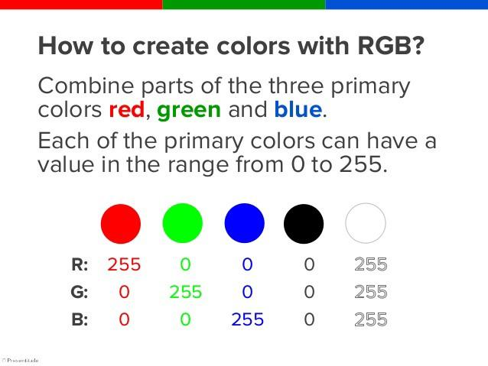
THE DATASET
Colors are made up of 3 primary colors; red, green, and blue.
In computers, we define each colour value within a range of 0 to 255. There are approximately 16.5 million different ways to represent a colour.
In our dataset, we need to map each color’s values with their corresponding names. So ,we will be using a dataset that contains RGB values with their corresponding names. Here we are going to use 865 colour names along with their RGB and hex values.
color-names/colors.csv at master · codebrainz/color-names · GitHub

Slide 14
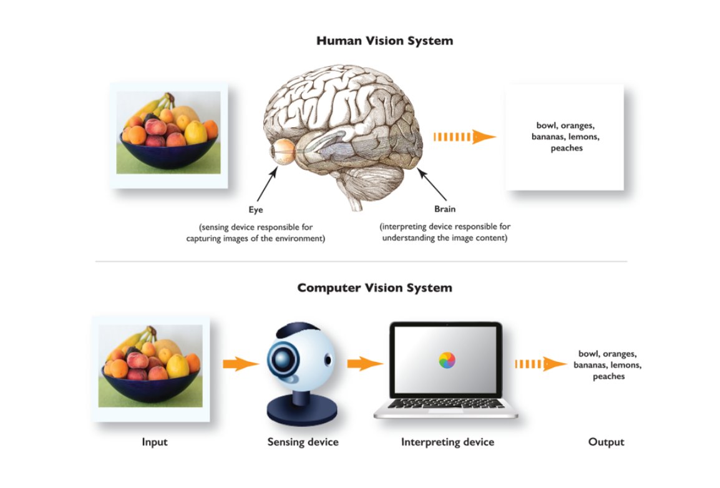
SYSTEM ARCHITECTURE

Slide 15
SYSTEM DESIGN
The image below shows how the complete process of colour detection is carried out.
IMAGE
IMAGE PROCESSING
CLICK ON PT. WHOSE COLOR IS TO BE CHECKED
OUTPUT

Slide 16
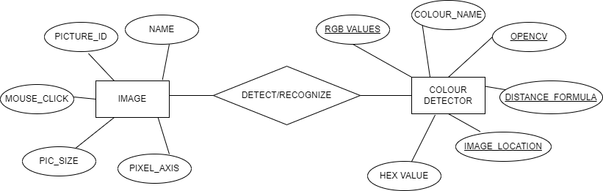
ER DIAGRAM

Slide 17
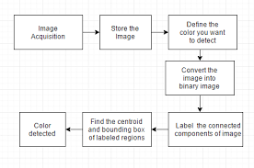
DFD

Slide 18
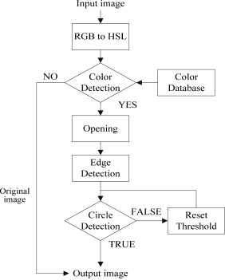

Slide 19
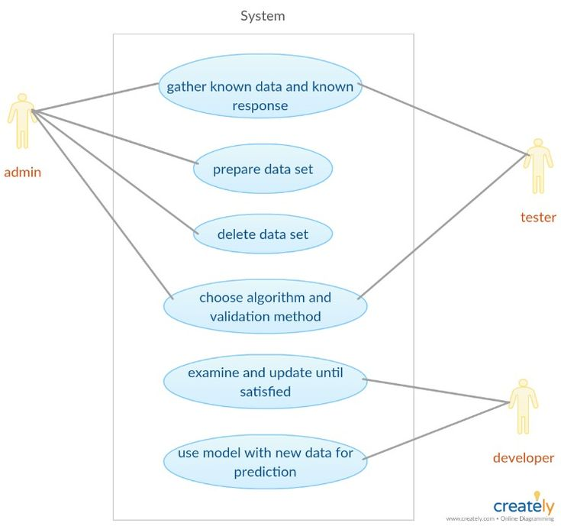
USECASE

Slide 20
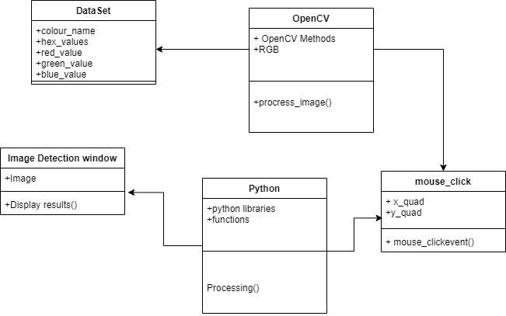
CLASS DIAGRAM

Slide 21
MODULES
Capturing and Storing Image
Image Processing
Color Detection

Slide 22
MODULE 1- CAPTURING AND STORING IMAGE
In this module, the capturing of image takes place. The image stored in this process is later used for detecting the colour.
The program stores the image and resizes it to 800*600 pixels of image the user gives in as input. The reduction of image size and leads to judicial use of the storage provided.

Slide 23
MODULE 2- IMAGE PROCESSING
In this module, when the program is executed the program opens a window of size 800*600 image pixel are processed an the program loads the image in the window.
In this module, the programs run over & gives the image for further operation.
When all the images are perfectly processed and the program is ready to detect the colour.

Slide 24
MODULE 3-COLOR DETECTION
In this module, the programs has completed the Image Processing and is ready to take the input of the user.
The program which is already displaying the window can now be clicked anywhere and it will display the colour present there.
The user Clicks on the image anywhere of which colour the user wants to know.

Slide 25
RUN PYTHON FILE
The project is now complete, we can run the Python file from the command prompt. Make sure to give an image path using ‘-i’ argument.
If the image is in another directory, then we need to give full path of the image:
python color_detection.py -i <add your image path here>

Slide 26
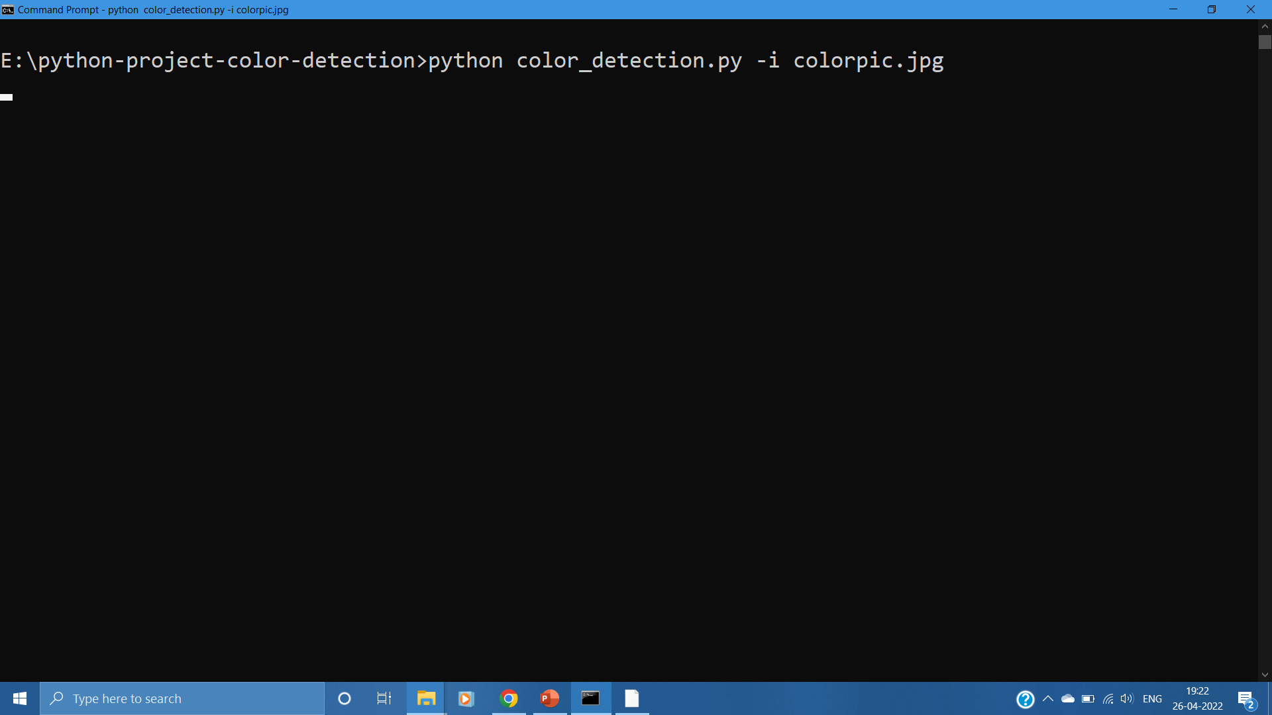

Slide 27
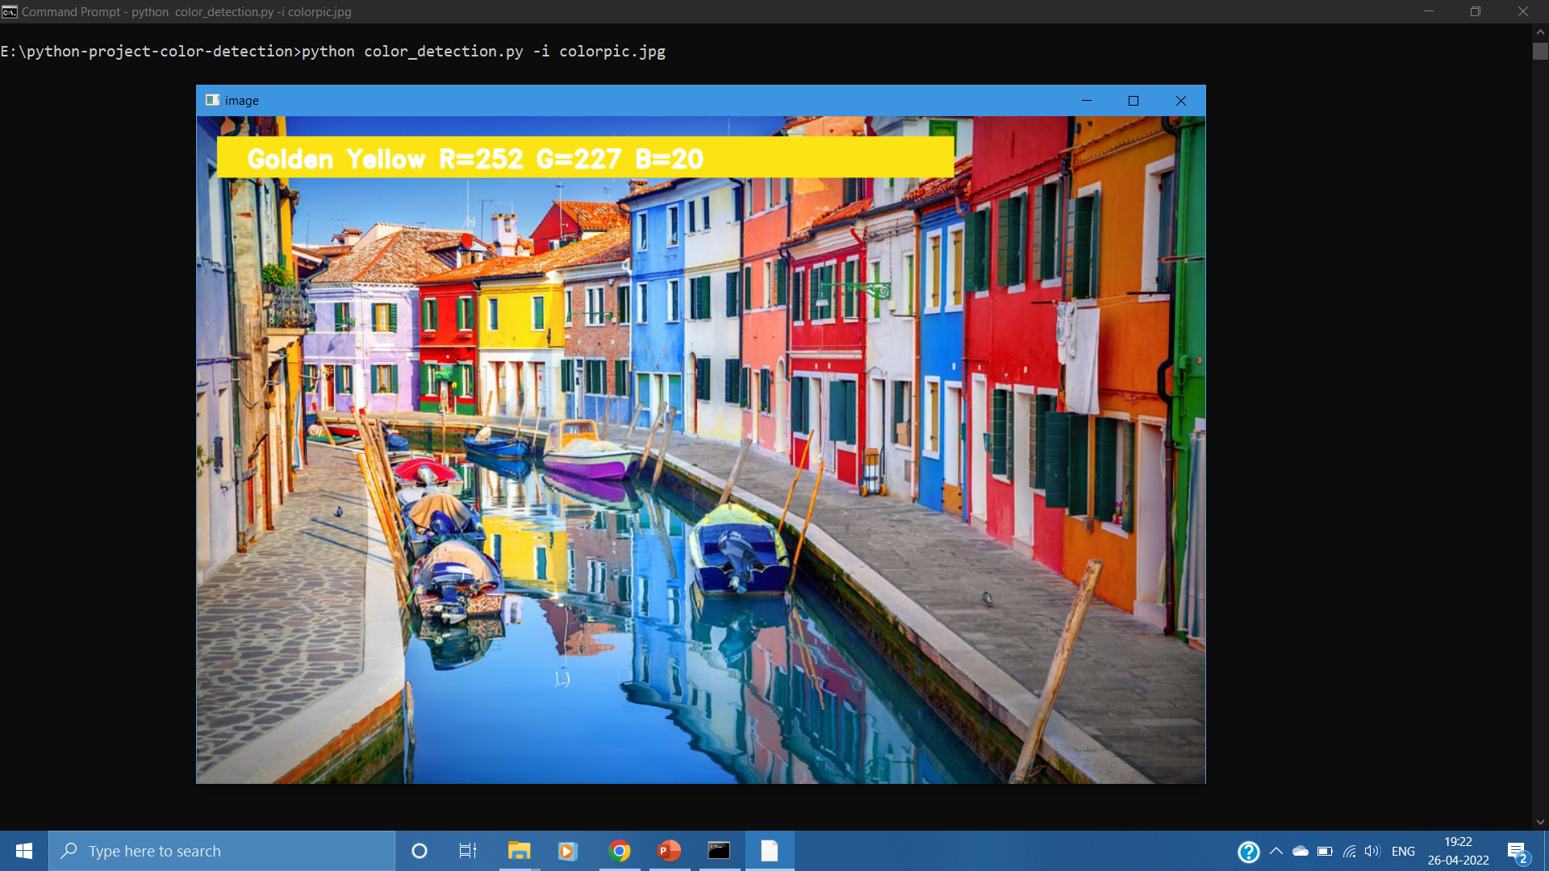
OUTPUT

Slide 28
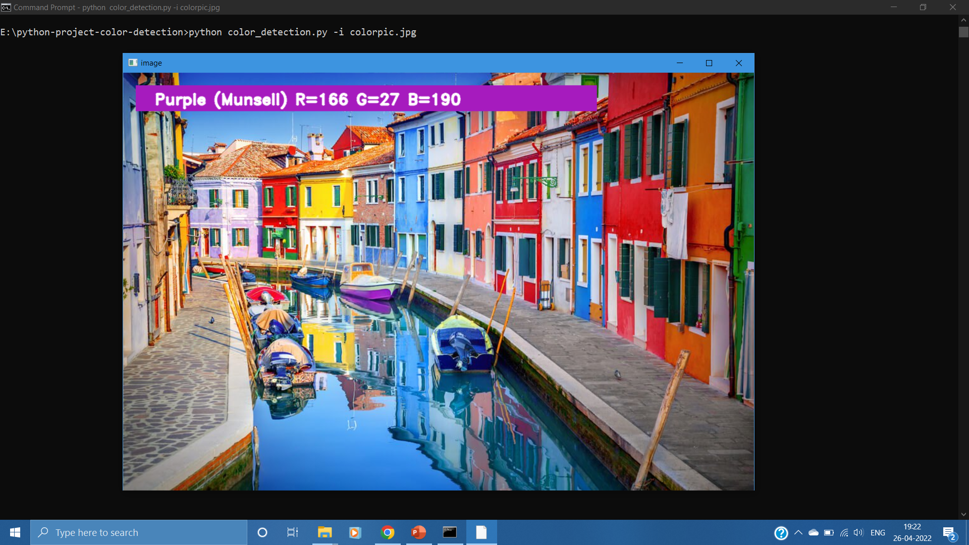

Slide 29
CONCLUSION
In this Python project , we learned about colors and how we can extract colour RGB values and the colour name of a pixel. We learned how to handle events like double-clicking on the window and saw how to read CSV files with pandas and perform operations on data.
This is used in numerous image editing and drawing apps.

Slide 30
REFERENCES
https://www.researchgate.net/publication/349355136_Color_Detection_of_RGB_Images_Using_Python_and_OpenCv
https://data-flair.training/blogs/project-in-python-colour-detection/
https://ieeexplore.ieee.org/document/9076168

